Slide 1



APACHE SPARK DEEP DIVE Spark Execution Model With Spark UI

Slide 2
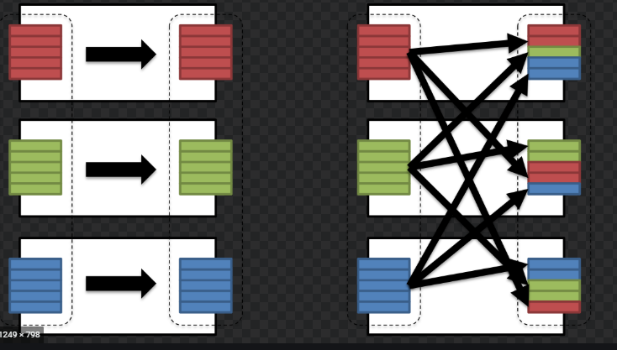

Spark Execution Model
In this video we will try to understand how spark application runs on a cluster.
An important thing to know about Dataset transformations is that they fall into two types, narrow and wide.

Slide 3
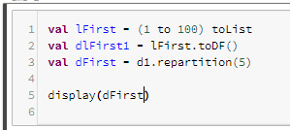
Spark Execution Model
Take an example

Slide 4

Spark Execution Model
The Logical Plan
In the first phase, the logical plan is created.
This is the plan that shows which steps will be executed when an action gets applied.
Recall that when you apply a transformation on a Dataset, a new Dataset is created.
When this happens, that new Dataset points back to the parent, resulting in a lineage or directed acyclic graph (DAG) for how Spark will execute these transformations.
The Physical Plan
Actions trigger the translation of the logical DAG into a physical execution plan. The Spark Catalyst query optimizer creates the physical execution plan for DataFrames, as shown in the diagram below:

Slide 5
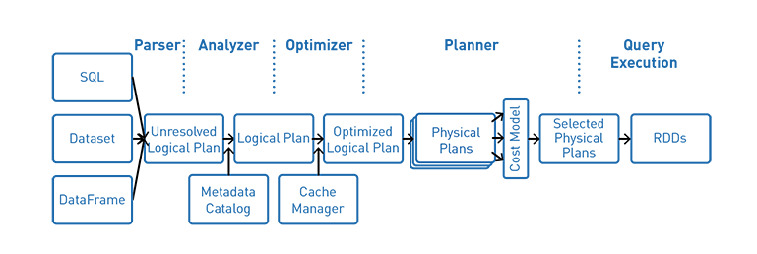

Spark Execution Model
Query Plan for the dFirst

Slide 6
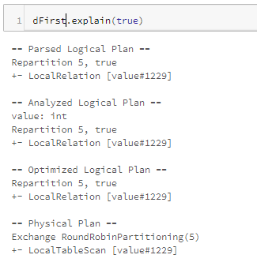

Spark Execution Model
Query Plan for the dFirst

Slide 7
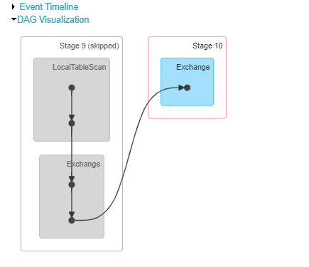

Spark Execution Model
Spark UI -> Jobs

Slide 8
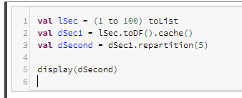

Spark Execution Model
Second DataFrame dSecond

Slide 9
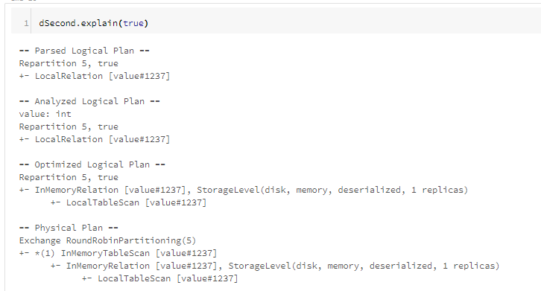

Spark Execution Model
Query Execution Plan

Slide 10
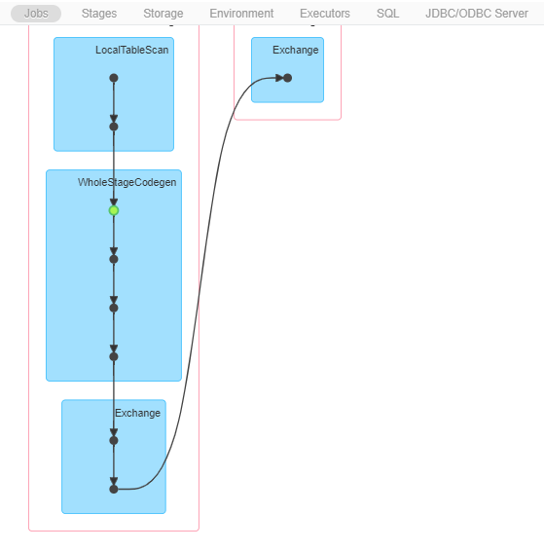

Spark Execution Model
Whole-Stage Java Code Generation
is a physical query optimization in Spark SQL that fuses multiple physical operators (as a subtree of plans) together into a single Java function.

Slide 11
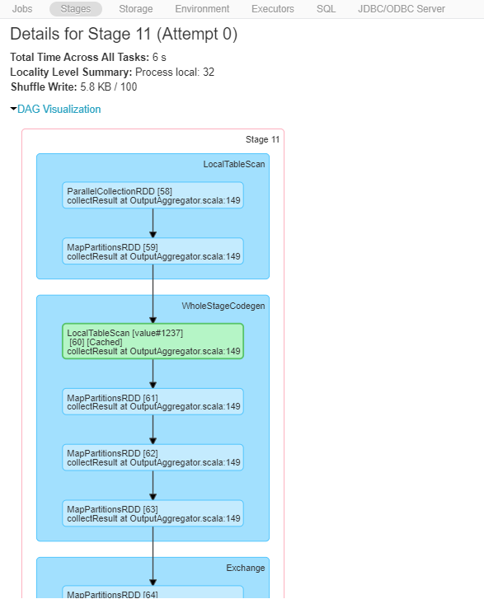
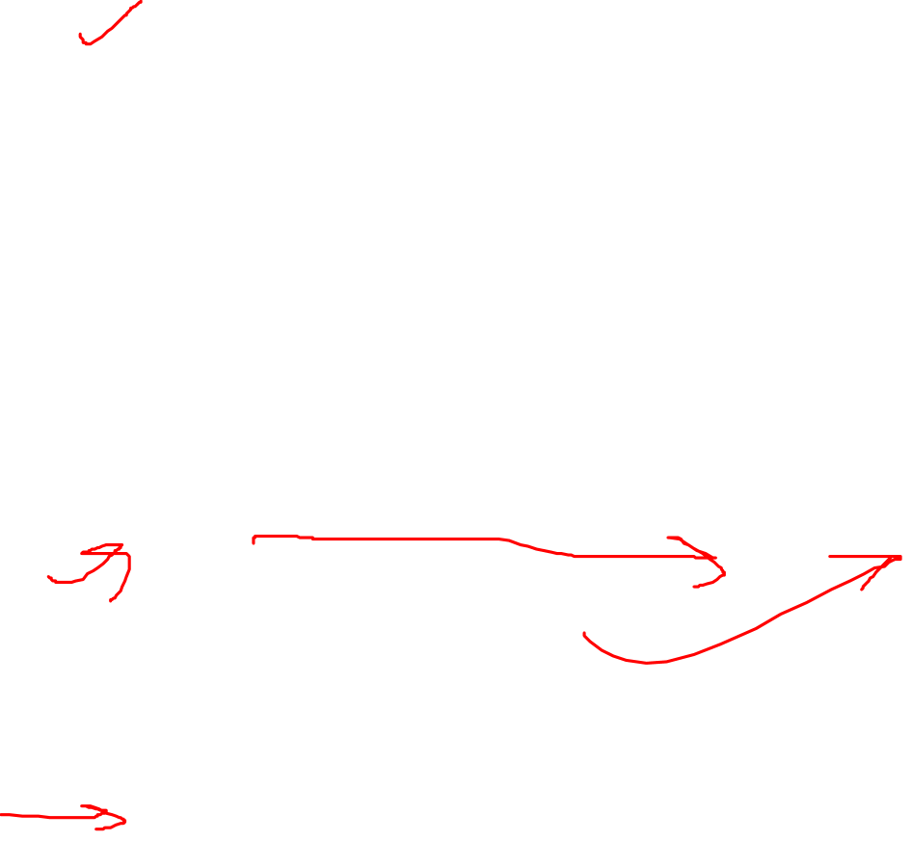
Spark Execution Model

Slide 12
Spark Execution Model
Thanks and do subscribe to my channel

